Slide 1

Wobbadex
A Wumbo Squad production.

Slide 2
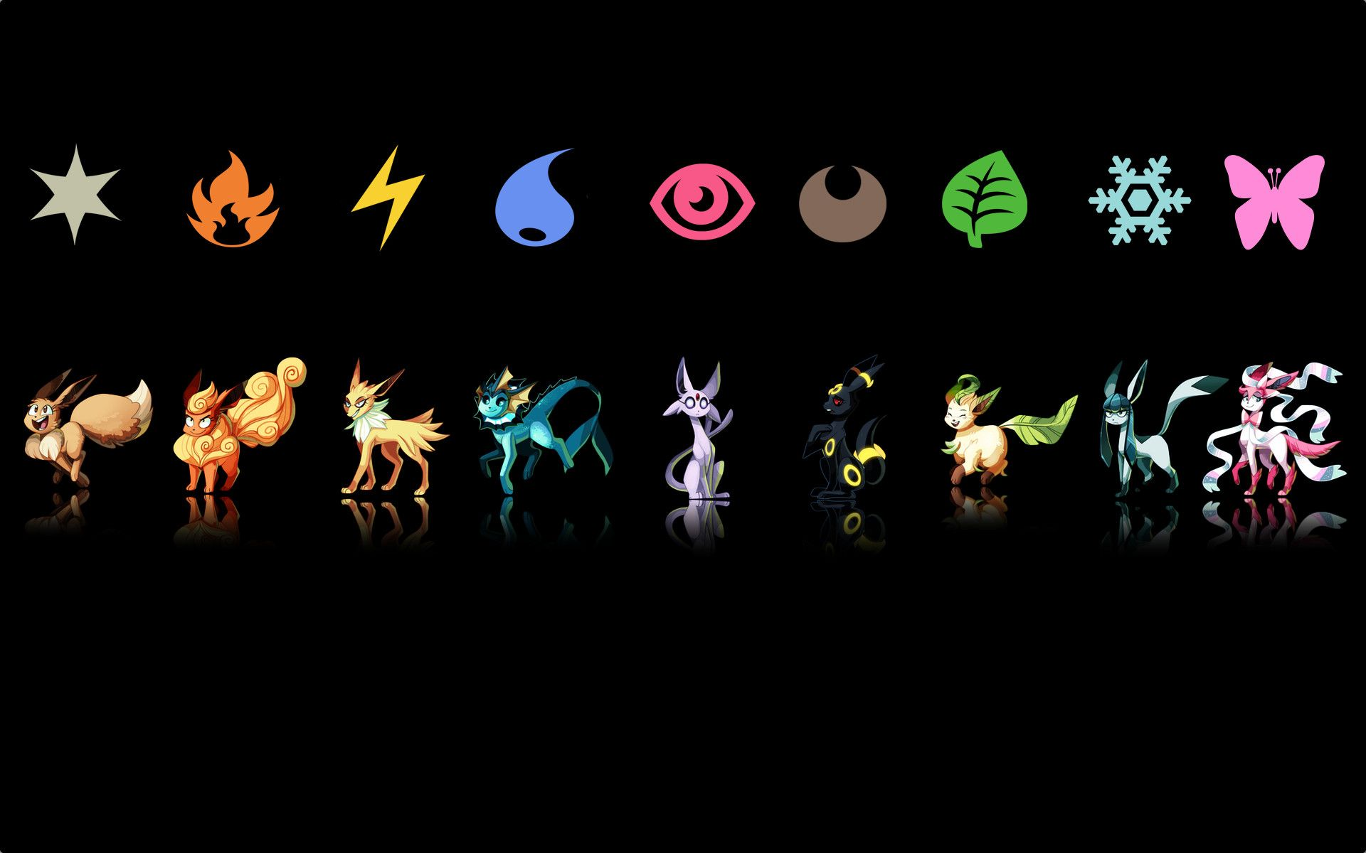
The Mission:
An interactive database about Pokémon similar to a Pokédex.
Provides information relevant to both beginners and veterans alike.
We provide picture of every pokémon.

Slide 3

OUR TEAM

Slide 4

Our Team:
Andrew Nickerl
Has been involved with programming for 9 years.
Served as a Data system administrator in the Marine Corps.
Passionate about coding and always driving for better results.

Slide 5
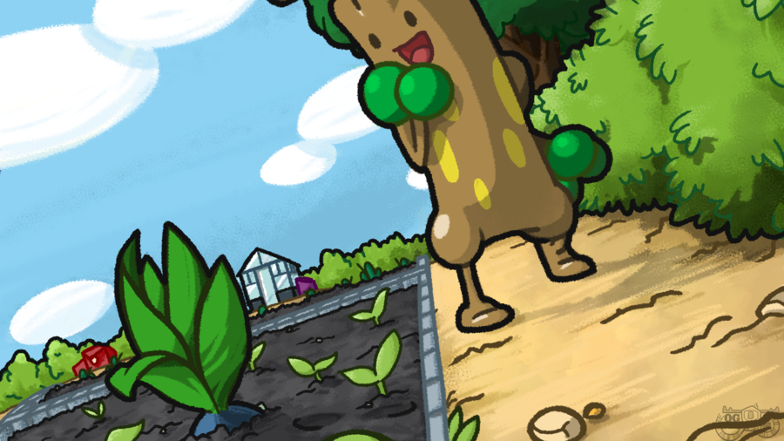
Our Team:
Anthony Dally
Experienced in multiple fields from the jobs he has held.
Served in the Marine Corps. as a Data Systems Admin with 3 years experience in IT support.
Looking to be challenged and break barriers.

Slide 6
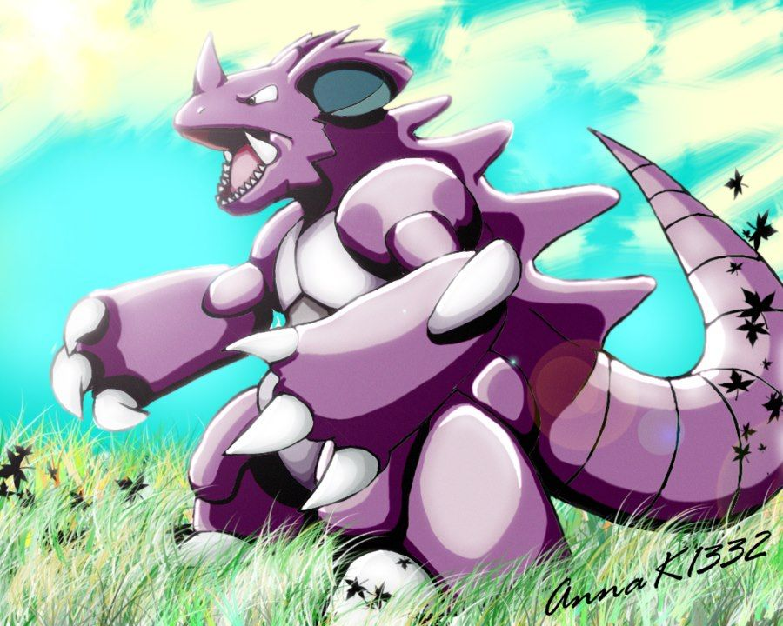
Our Team:
Ben Letbetter
Involved in the tech field for 12 years.
Served as a Computer Technician for 5 years in the Marine Corps.
Current MSSA student.
Resident Pokémon expert.

Slide 7
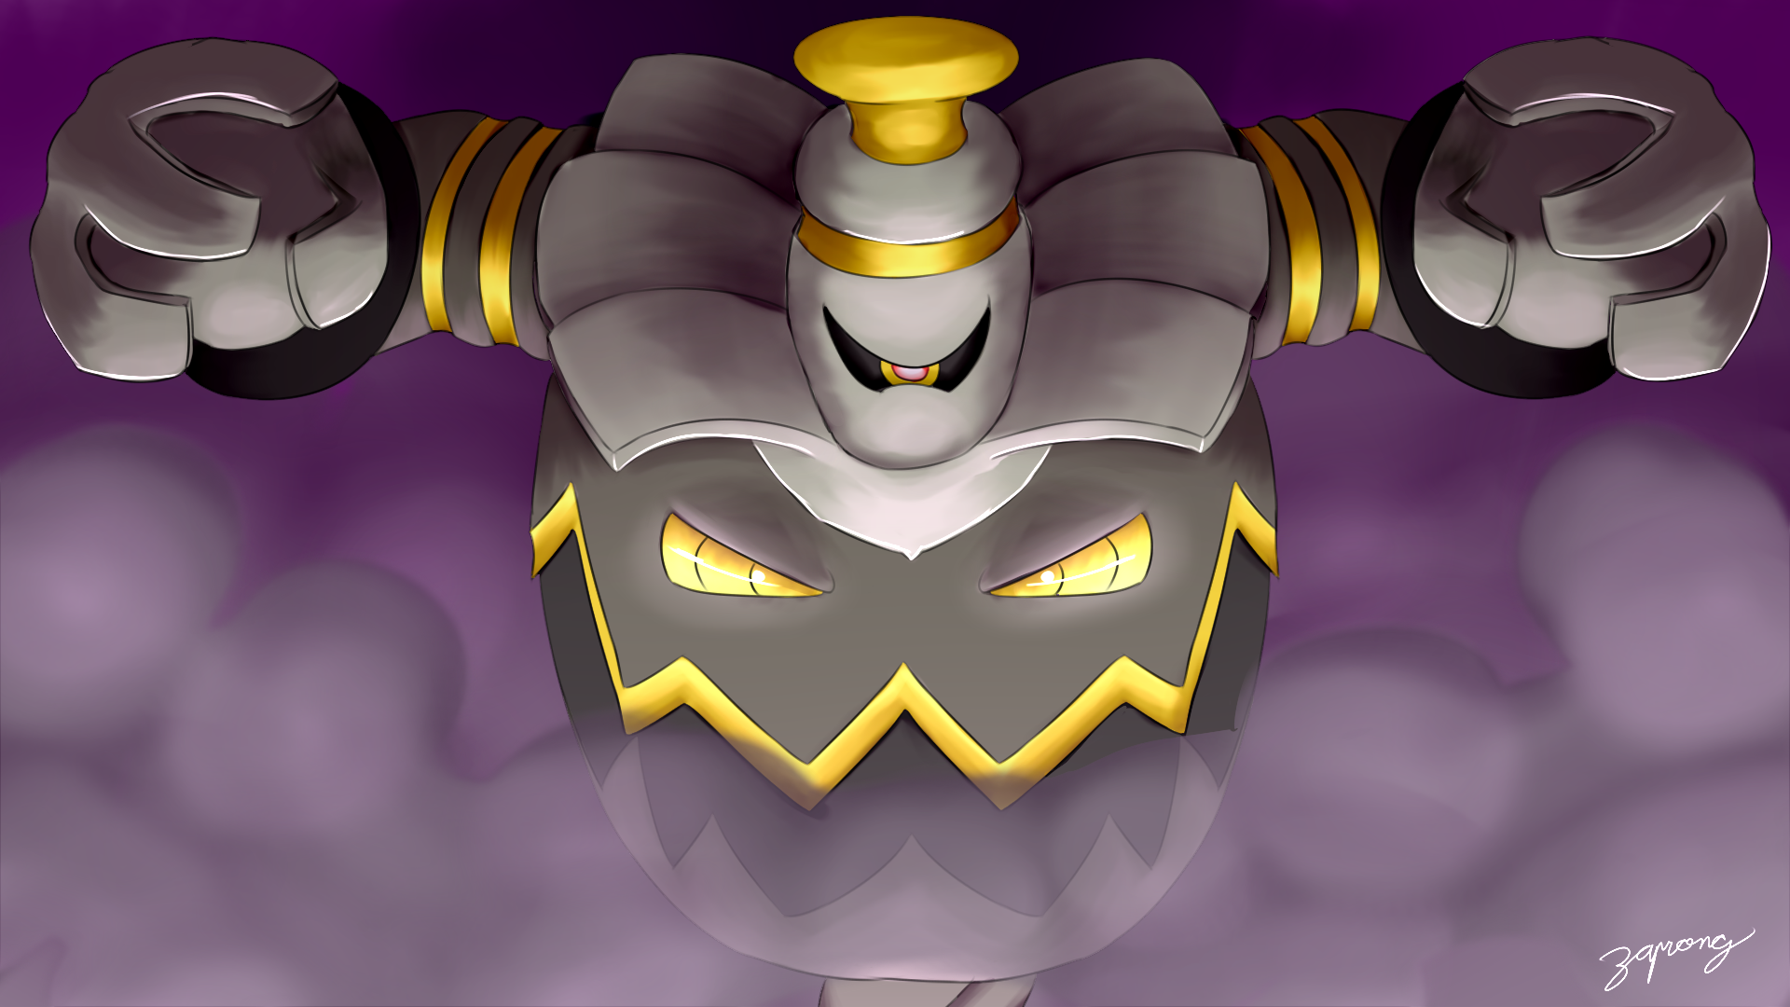
Our Team:
Charles Gaines
20 years experience logistics manager in the Marine Corps.
MSSA Student
Great organizer and data management supervisor.

Slide 8

Our Team:
Jackson Phillips
Was a team leader in the infantry in the Marine Corps.
Current MSSA student
Wants to make things that will help people.

Slide 9

Features

Slide 10

Features:
Individual Entries:
Pokémon Names
Pokémon Types
Pokémon Evolution Lines
Image of Pokémon
Base Stats

Slide 11
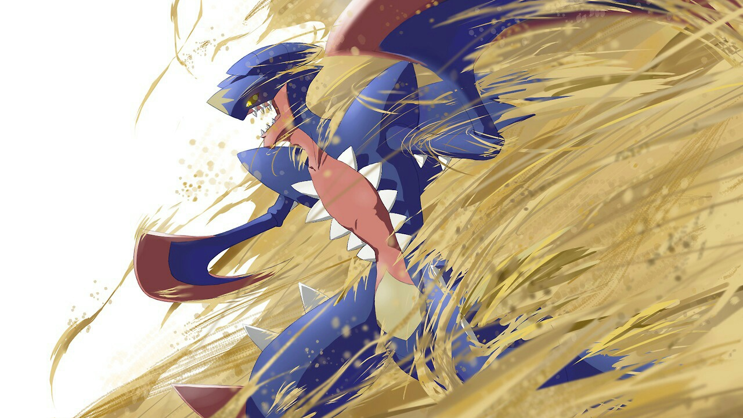
Features:
App Handling:
Easy to use
Interactive
Aesthetically pleasing

Slide 12
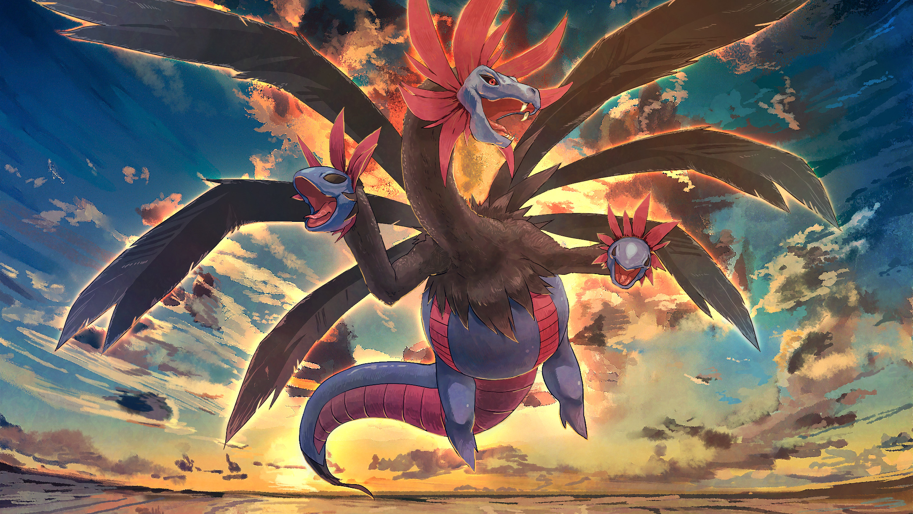
IMPLEMENTATION

Slide 13

Implementation:
T-SQL:
Foundation of the app
Location for database

Slide 14
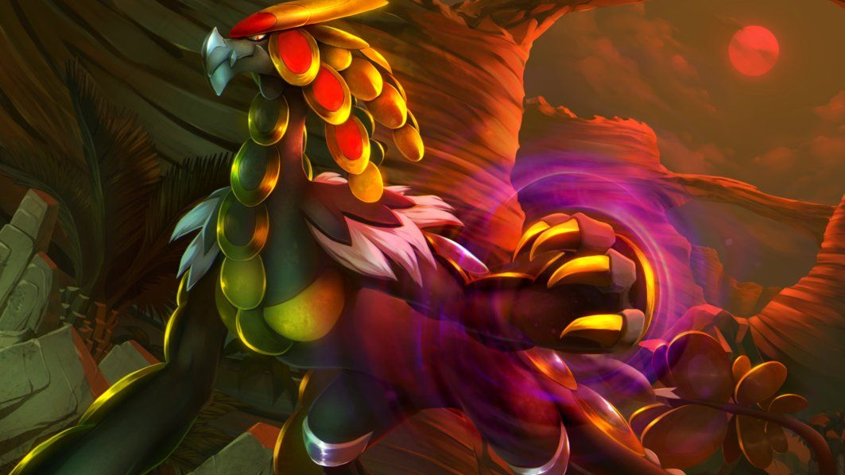
Implementation:
C#:
Glue of the app
Provides Functionality
Connects everything together

Slide 15

Implementation:
ASP.NET:
Face of the app
Provides the User Interface

Slide 16

GOALS

Slide 17

Goals:
Practical:
Implement all features
Include all of generation 1

Slide 18
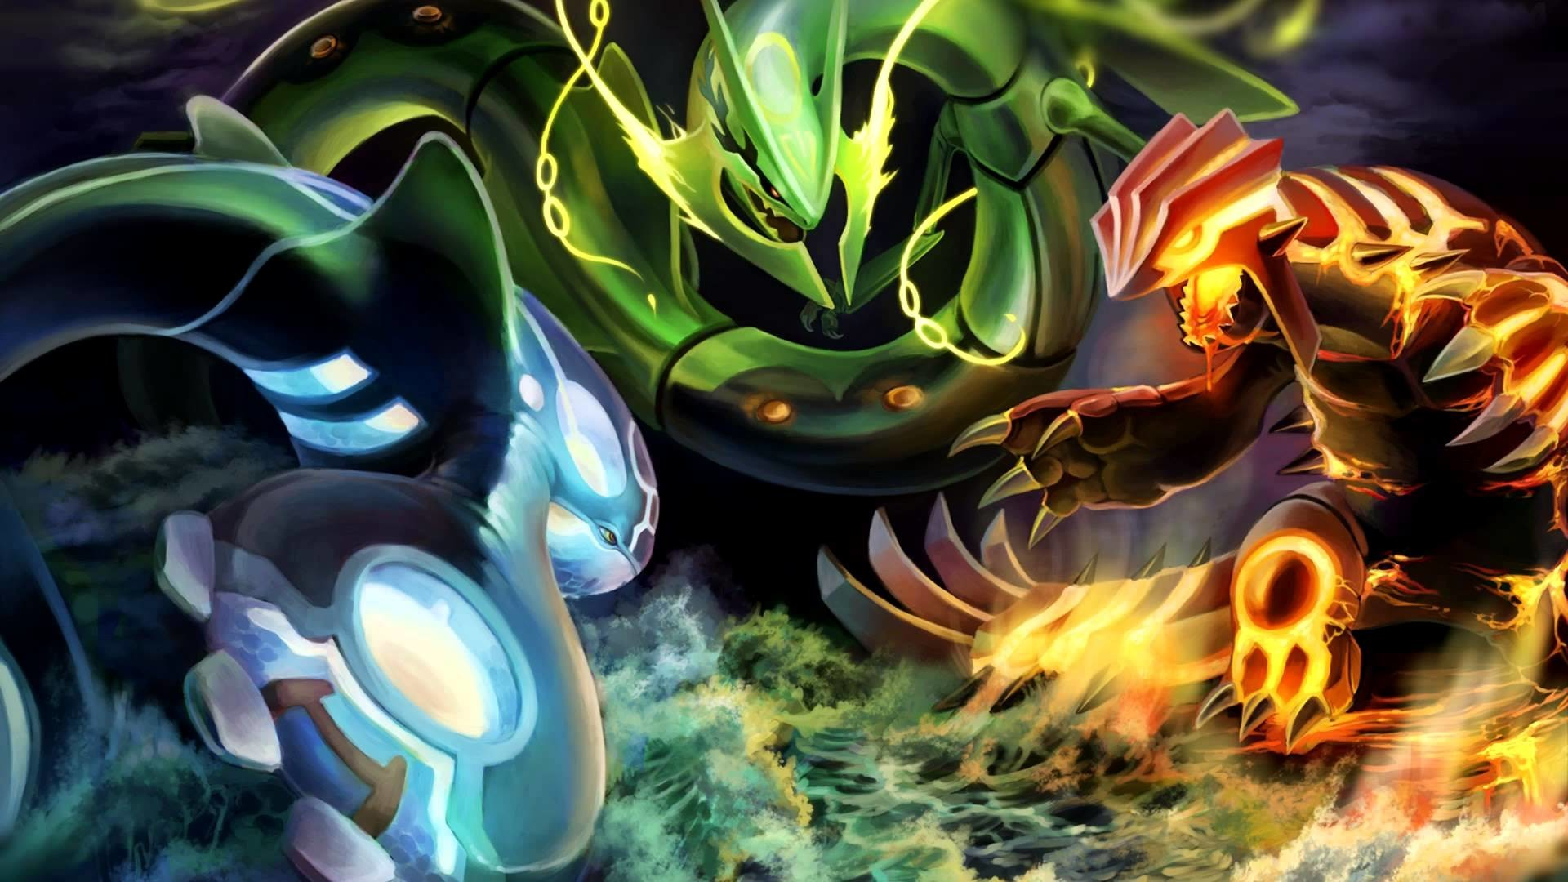
Goals:
Hopeful:
Every Generation
Cries of Pokémon
Reader Voice
Battle move list

Slide 19

Reference:
Bulbapedia
Serebii
Pokedex 10

